Slide 1
Policy Iteration
Alternative approach for optimal values:
Step 1: Policy evaluation: calculate utilities for some fixed policy (not optimal utilities!) until convergence
Step 2: Policy improvement: update policy using one-step look-ahead with resulting converged (but not optimal!) utilities as future values
Repeat steps until policy converges
This is policy iteration
It’s still optimal!
Can converge (much) faster under some conditions
Notes:
We’re going to look at an alternate called policy evaluation.

Slide 2
Policy Iteration
Evaluation: For fixed current policy π, find values with policy evaluation:
Iterate until values converge:
Improvement: For fixed values, get a better policy using policy extraction
One-step look-ahead:
Notes:
If we wrote this out in equation, it would look like this.
Step 1 is evaluation. I do this simplified update where I don’t max over the actions. I only do the averaging on the chance nodes. It’s fast, since I don’t consider all of the actions. I do this until it convergences.
Step 2 is the improvement. I do one layer of expectimax. Our truncation function is the old policy. That’s a bit weird right? I’m pushing the old stuff one step into the future and thereby make progress.
If you think about this, the improvement step is just like value iteration. So it’s not going to be very fast. All of the speed gains come from the evaluation step. So we run that many times before allowing an improvement step.

Slide 3
Comparison
Both value iteration and policy iteration compute the same thing (all optimal values)
In value iteration:
Every iteration updates both the values and (implicitly) the policy
We don’t track the policy, but taking the max over actions implicitly recomputes it
In policy iteration:
We do several passes that update utilities with fixed policy (each pass is fast because we consider only one action, not all of them)
After the policy is evaluated, a new policy is chosen (slow like a value iteration pass)
The new policy will be better (or we’re done)
Both are dynamic programs for solving MDPs
Notes:
OK, let’s compare them. They do the same thing. Both take in an MDP. They both output an optimal quality. On the surface they both output optimal values. Policy iteration explicitly outputs the optimal policy, value iteration does it implicitly.
Both are the same class of things. They are dynamic programs for solving MDPs.

Slide 4
Summary: MDP Algorithms
So you want to….
Compute optimal values: use value iteration or policy iteration
Compute values for a particular policy: use policy evaluation
Turn your values into a policy: use policy extraction (one-step lookahead)
These all look the same!
They basically are – they are all variations of Bellman updates
They all use one-step lookahead expectimax fragments
They differ only in whether we plug in a fixed policy or max over actions
Notes:
These are all Bellman equations turned into a one step look ahead.

Slide 5
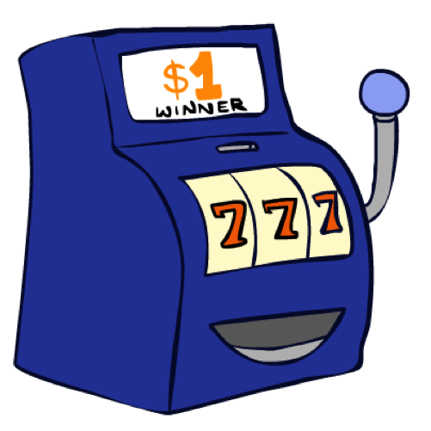
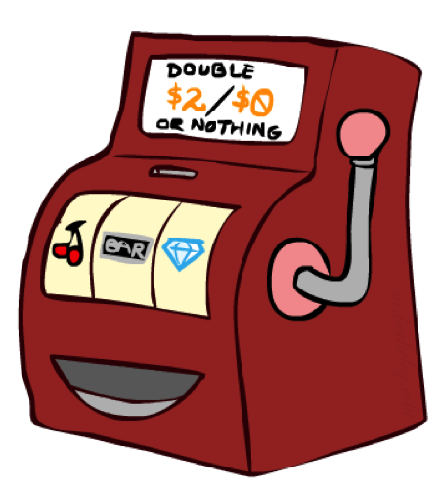

Double Bandits
Notes:
Keep for next time.

Slide 6
Double-Bandit MDP
Actions: Blue, Red
States: Win, Lose
No discount
100 time steps
Both states have the same value
0.25 $0
0.75
$2
W
L
0.25
$0
$1
1.0
$1
1.0
0.75 $2

Slide 7
Offline Planning
Solving MDPs is offline planning
You determine all quantities through computation
You need to know the details of the MDP
You do not actually play the game!
No discount
100 time steps
Both states have the same value
0.25 $0
Value
0.75
$2
W
0.25
$0
Play Red
150
L
$1
1.0
$1
1.0
0.75 $2
Play Blue
100

Slide 8
Let’s Play!
$2
$2
$0
$2
$2
$2
$2
$0
$0
$0

Slide 9
Online Planning
Rules changed! Red’s win chance is different.
?? $0
??
$2
W
L
??
$0
$1
1.0
$1
1.0
?? $2
Notes:
Now we aren’t given the probabilities. Red has a payoff but you don’t know what it is.
So what should we do? Give up and go home? No, let’s try it out by playing.

Slide 10
Let’s Play!
$0
$0
$0
$2
$0
$2
$0
$0
$0
$0
Notes:
What should we play? Red! Red! Red! When should we stop?

Slide 11
What Just Happened?
That wasn’t planning, it was learning!
Specifically, reinforcement learning
There was an MDP, but you couldn’t solve it with just computation
You needed to actually act to figure it out
Important ideas in reinforcement learning that came up
Exploration: you have to try unknown actions to get information
Exploitation: eventually, you have to use what you know
Regret: even if you learn intelligently, you make mistakes
Sampling: because of chance, you have to try things repeatedly
Difficulty: learning can be much harder than solving a known MDP

Slide 12

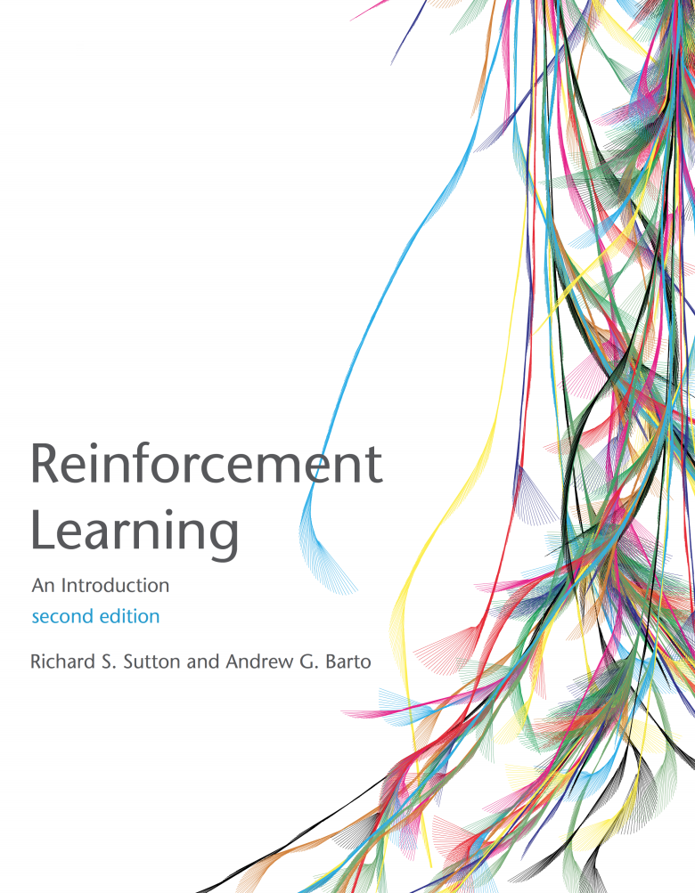
Markov Decision Processes 2
Read AIMA 17.1-17.3
Also read Sutton and Barton Chapter 3 (see link on course web site)

Slide 13
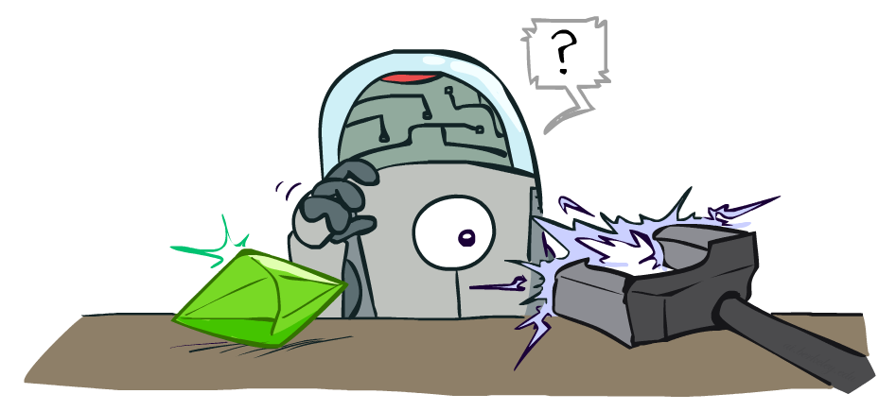
Reinforcement Learning
Slides courtesy of Dan Klein and Pieter Abbeel --- University of California, Berkeley
[These slides were created by Dan Klein and Pieter Abbeel for CS188 Intro to AI at UC Berkeley. All CS188 materials are available at http://ai.berkeley.edu.]
Notes:
Please retain proper attribution, including the reference to ai.berkeley.edu. Thanks!

Slide 14
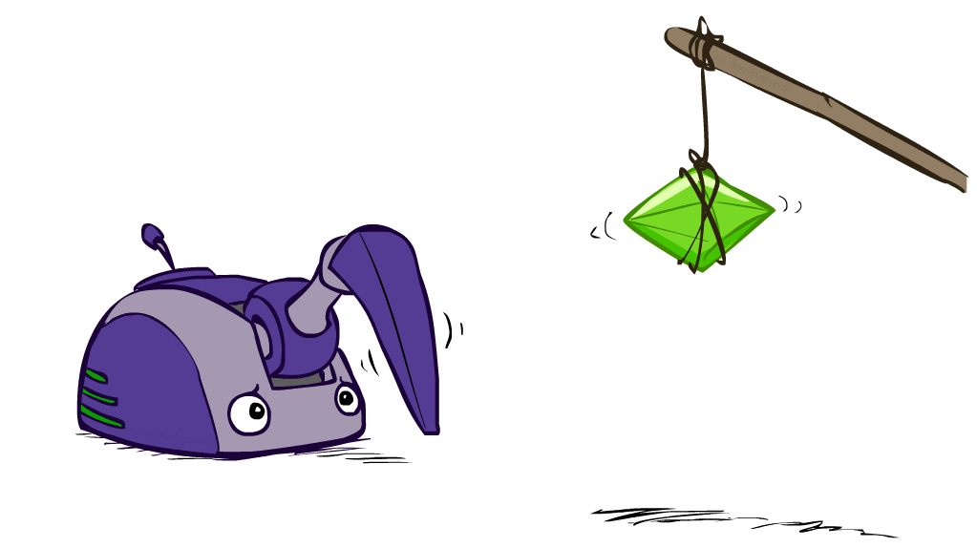
Reinforcement Learning

Slide 15
Reinforcement Learning
Agent
State: s
Reward: r
Actions: a
Environment
Basic idea:
Receive feedback in the form of rewards
Agent’s utility is defined by the reward function
Must (learn to) act so as to maximize expected rewards
All learning is based on observed samples of outcomes!
Notes:
Show robot-soccer learning to walk videos (UT Austin):
? Show snake robot:

Slide 16
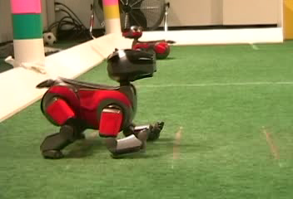

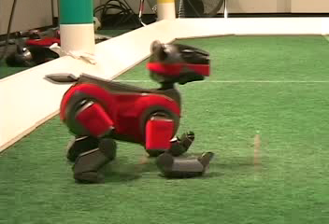
Example: Learning to Walk
Initial
A Learning Trial
After Learning [1K Trials]
[Kohl and Stone, ICRA 2004]

Slide 17

Example: Learning to Walk
Initial
[Kohl and Stone, ICRA 2004]
[Video: AIBO WALK – initial]

Slide 18

Example: Learning to Walk
Training
[Kohl and Stone, ICRA 2004]
[Video: AIBO WALK – training]

Slide 19

Example: Learning to Walk
Finished
[Kohl and Stone, ICRA 2004]
[Video: AIBO WALK – finished]

Slide 20
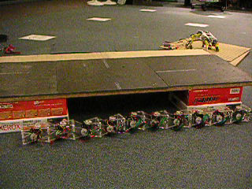
Example: Sidewinding
[Andrew Ng]
[Video: SNAKE – climbStep+sidewinding]

Slide 21

Example: Toddler Robot
[Tedrake, Zhang and Seung, 2005]
[Video: TODDLER – 40s]

Slide 22
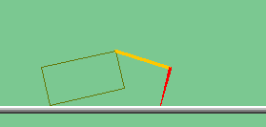
The Crawler!
[Demo: Crawler Bot (L10D1)] [You, in Project 3]
Notes:
At times no reward accumulated at all, just sitting still

Slide 23
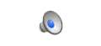
Video of Demo Crawler Bot

Slide 24
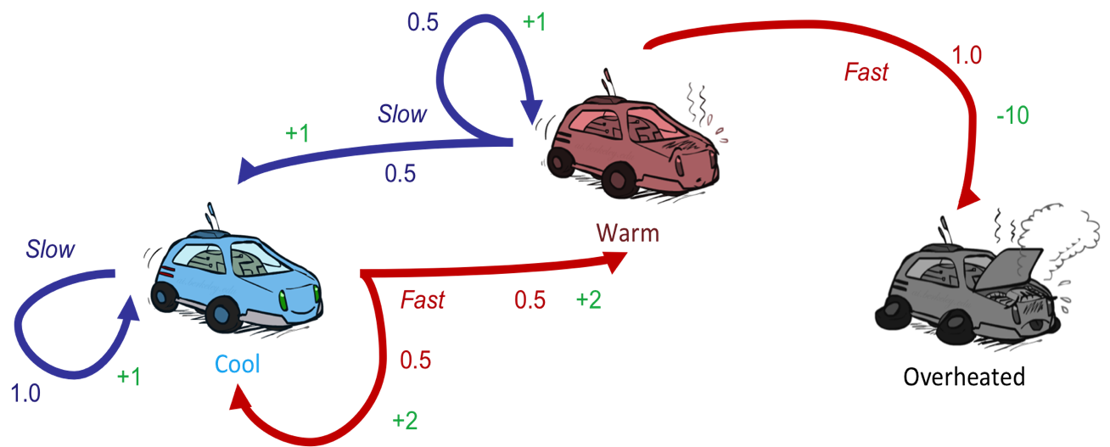
Reinforcement Learning
Still assume a Markov decision process (MDP):
A set of states s ∈ S
A set of actions (per state) A
A model T(s,a,s’)
A reward function R(s,a,s’)
Still looking for a policy π(s)
New twist: don’t know T or R
I.e. we don’t know which states are good or what the actions do
Must actually try actions and states out to learn

Slide 25
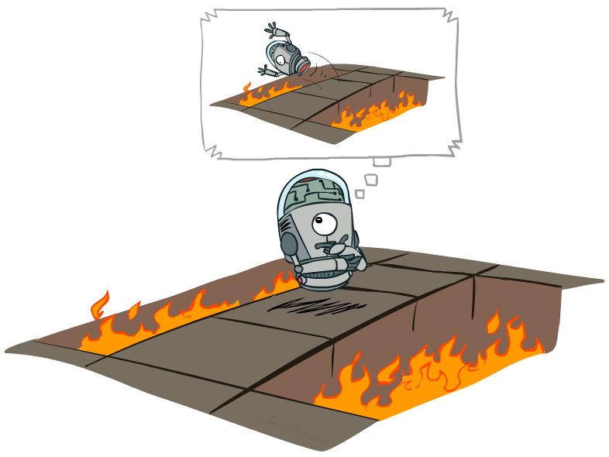
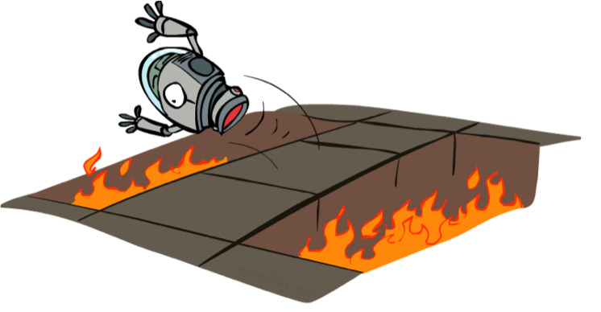
Offline (MDPs) vs. Online (RL)
Offline Solution
Online Learning

Slide 26
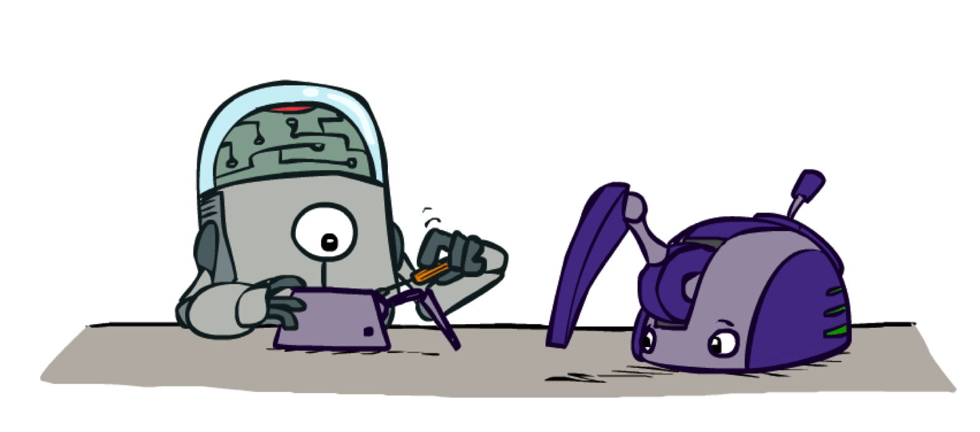
Model-Based Learning

Slide 27

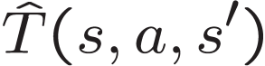

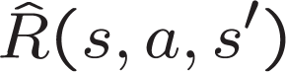
Model-Based Learning
Model-Based Idea:
Learn an approximate model based on experiences
Solve for values as if the learned model were correct
Step 1: Learn empirical MDP model
Count outcomes s’ for each s, a
Normalize to give an estimate of
Discover each when we experience (s, a, s’)
Step 2: Solve the learned MDP
For example, use value iteration, as before

Slide 28
Example: Model-Based Learning
Input Policy π
Observed Episodes (Training)
Learned Model
Episode 1
Episode 2
T(s,a,s’).
T(B, east, C) = 1.00
T(C, east, D) = 0.75
T(C, east, A) = 0.25
…
R(s,a,s’).
R(B, east, C) = -1
R(C, east, D) = -1
R(D, exit, x) = +10
…
 | A
B | C | D
 | E
B, east, C, -1
C, east, D, -1
D, exit, x, +10
B, east, C, -1
C, east, D, -1
D, exit, x, +10
Episode 3
Episode 4
E, north, C, -1
C, east, D, -1
D, exit, x, +10
E, north, C, -1
C, east, A, -1
A, exit, x, -10
Assume: γ = 1

Slide 29
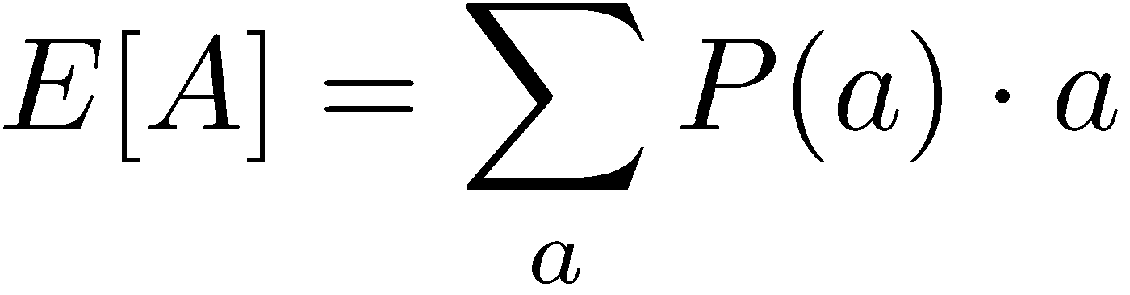
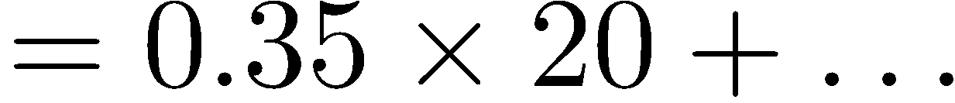
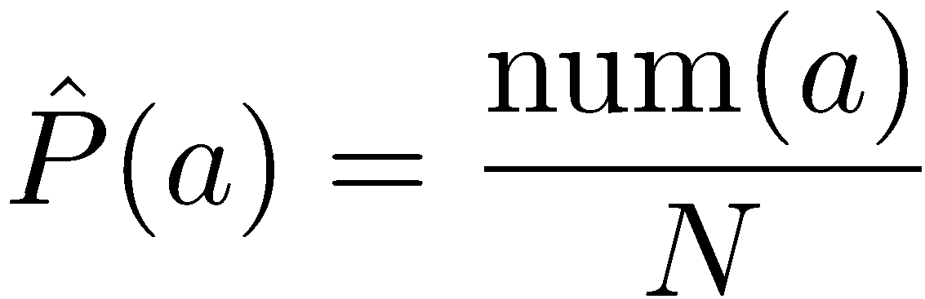
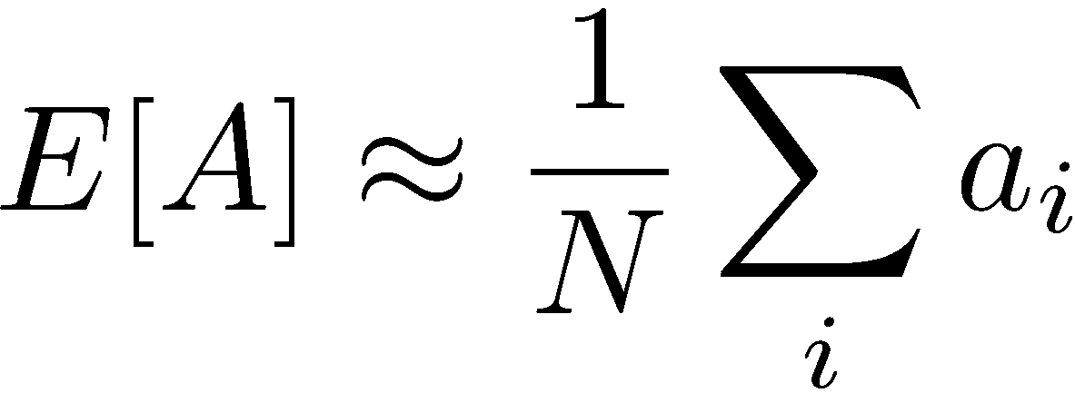
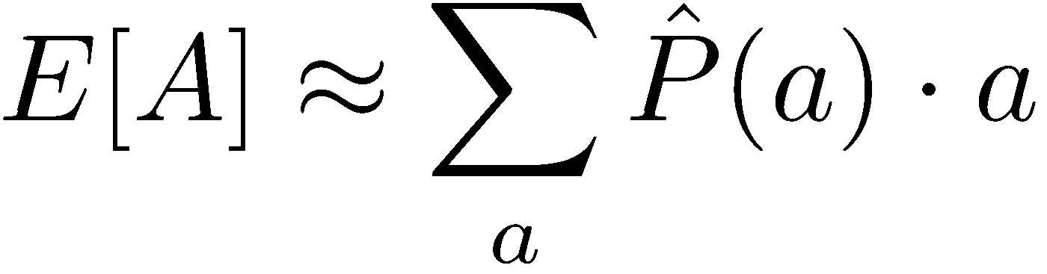
Example: Expected Age
Goal: Compute expected age of cs188 students
Known P(A)
Without P(A), instead collect samples [a₁, a₂, … a_{N}]
Unknown P(A): “Model Based”
Unknown P(A): “Model Free”
Why does this work? Because eventually you learn the right model.
Why does this work? Because samples appear with the right frequencies.

Slide 30
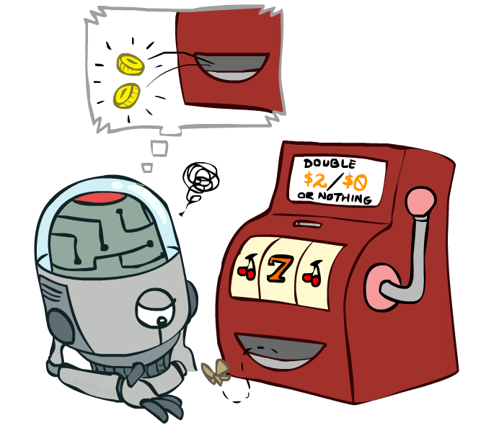
Model-Free Learning

Slide 31
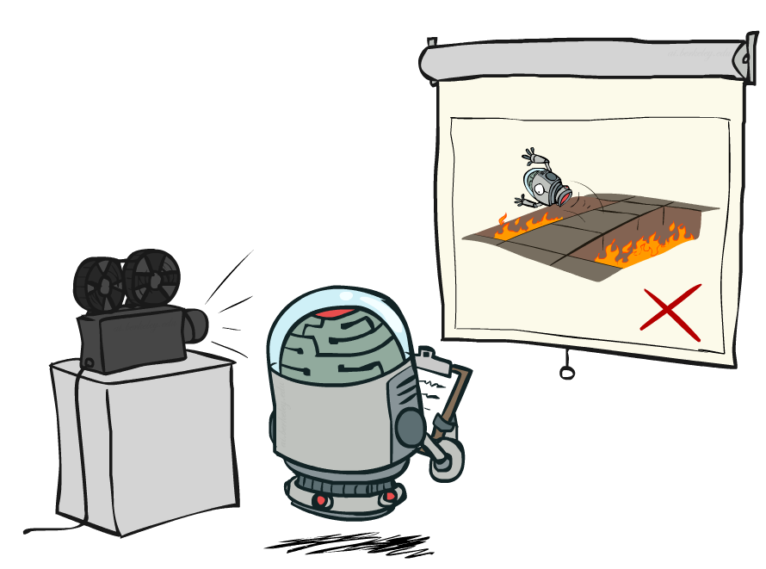
Passive Reinforcement Learning

Slide 32

Passive Reinforcement Learning
Simplified task: policy evaluation
Input: a fixed policy π(s)
You don’t know the transitions T(s,a,s’)
You don’t know the rewards R(s,a,s’)
Goal: learn the state values
In this case:
Learner is “along for the ride”
No choice about what actions to take
Just execute the policy and learn from experience
This is NOT offline planning! You actually take actions in the world.

Slide 33
Direct Evaluation
Goal: Compute values for each state under π
Idea: Average together observed sample values
Act according to π
Every time you visit a state, write down what the sum of discounted rewards turned out to be
Average those samples
This is called direct evaluation

Slide 34
Example: Direct Evaluation
Input Policy π
Observed Episodes (Training)
Output Values
Episode 1
Episode 2
 | A
B | C | D
 | E
 | A
B | C | D
 | E
B, east, C, -1
C, east, D, -1
D, exit, x, +10
B, east, C, -1
C, east, D, -1
D, exit, x, +10
-10
+8
+4
+10
Episode 3
Episode 4
-2
E, north, C, -1
C, east, D, -1
D, exit, x, +10
E, north, C, -1
C, east, A, -1
A, exit, x, -10
Assume: γ = 1

Slide 35
Problems with Direct Evaluation
What’s good about direct evaluation?
It’s easy to understand
It doesn’t require any knowledge of T, R
It eventually computes the correct average values, using just sample transitions
What bad about it?
It wastes information about state connections
Each state must be learned separately
So, it takes a long time to learn
Output Values
 | A
B | C | D
 | E
-10
+8
+4
+10
-2
If B and E both go to C under this policy, how can their values be different?

Slide 36

Why Not Use Policy Evaluation?
s
Simplified Bellman updates calculate V for a fixed policy:
Each round, replace V with a one-step-look-ahead layer over V
This approach fully exploited the connections between the states
Unfortunately, we need T and R to do it!
Key question: how can we do this update to V without knowing T and R?
In other words, how to we take a weighted average without knowing the weights?
π(s)
s, π(s)
s, π(s),s’
s’

Slide 37
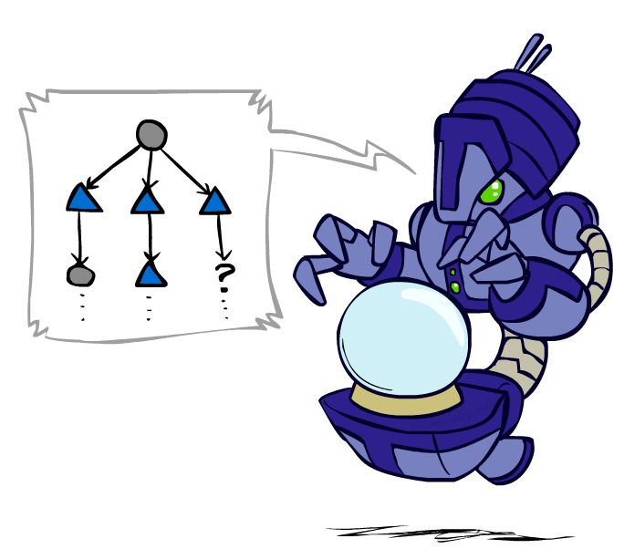
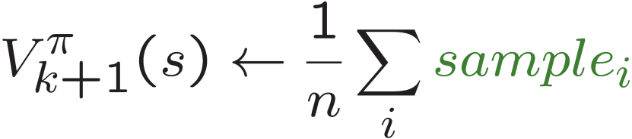
Sample-Based Policy Evaluation?
We want to improve our estimate of V by computing these averages:
Idea: Take samples of outcomes s’ (by doing the action!) and average
s
π(s)
s, π(s)
s, π(s),s’
s₁'
s₂'
s'
s₃'
Almost! But we can’t rewind time to get sample after sample from state s.

Slide 38
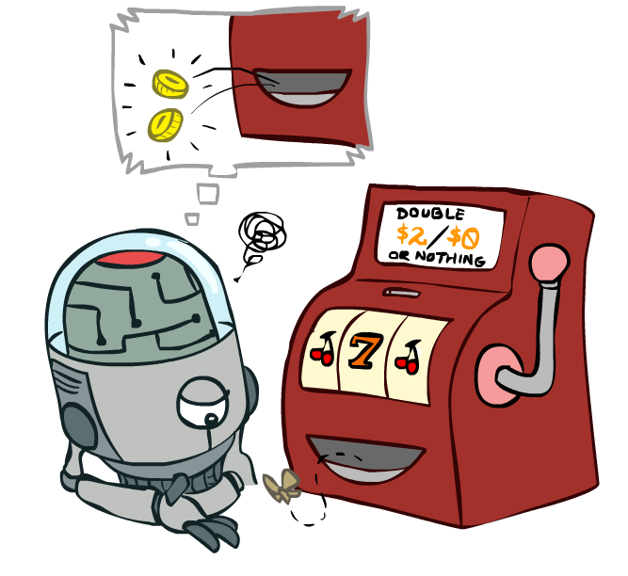
Temporal Difference Learning

Slide 39
Temporal Difference Learning
Big idea: learn from every experience!
Update V(s) each time we experience a transition (s, a, s’, r)
Likely outcomes s’ will contribute updates more often
Temporal difference learning of values
Policy still fixed, still doing evaluation!
Move values toward value of whatever successor occurs: running average
s
π(s)
s, π(s)
s’
Sample of V(s):
Update to V(s):
Same update:

Slide 40
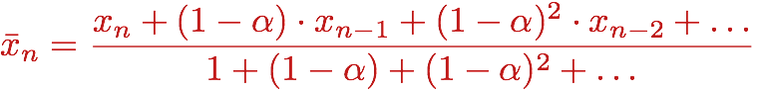
Exponential Moving Average
Exponential moving average
The running interpolation update:
Makes recent samples more important:
Forgets about the past (distant past values were wrong anyway)
Decreasing learning rate (alpha) can give converging averages

Slide 41
Example: Temporal Difference Learning
States
Observed Transitions
B, east, C, -2
C, east, D, -2
 | A
B | C | D
 | E
 | 0
0 | 0 | 8
 | 0
 | 0
-1 | 0 | 8
 | 0
 | 0
-1 | 3 | 8
 | 0
Assume: γ = 1, α = 1/2

Slide 42
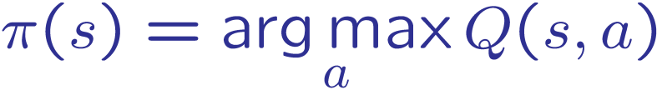
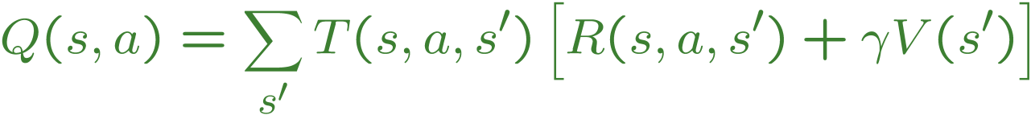
Problems with TD Value Learning
TD value leaning is a model-free way to do policy evaluation, mimicking Bellman updates with running sample averages
However, if we want to turn values into a (new) policy, we’re sunk:
Idea: learn Q-values, not values
Makes action selection model-free too!
s
a
s, a
s,a,s’
s’

Slide 43
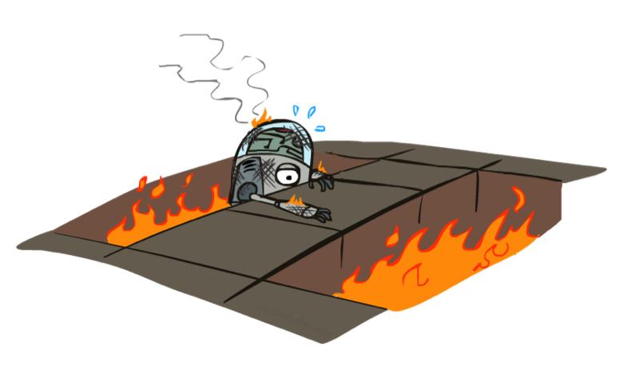
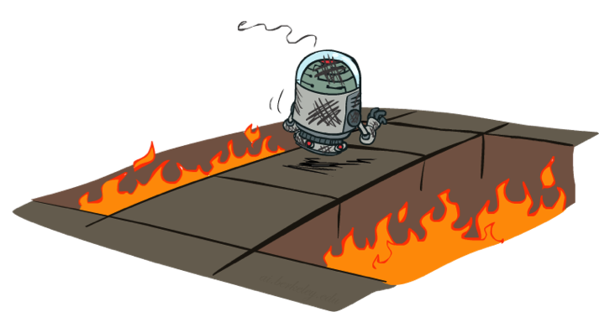
Active Reinforcement Learning

Slide 44
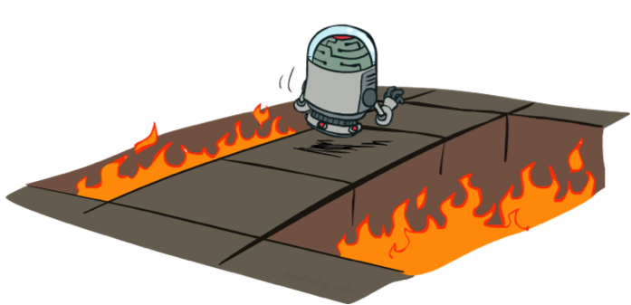
Active Reinforcement Learning
Full reinforcement learning: optimal policies (like value iteration)
You don’t know the transitions T(s,a,s’)
You don’t know the rewards R(s,a,s’)
You choose the actions now
Goal: learn the optimal policy / values
In this case:
Learner makes choices!
Fundamental tradeoff: exploration vs. exploitation
This is NOT offline planning! You actually take actions in the world and find out what happens…

Slide 45
Detour: Q-Value Iteration
Value iteration: find successive (depth-limited) values
Start with V₀(s) = 0, which we know is right
Given V_{k}, calculate the depth k+1 values for all states:
But Q-values are more useful, so compute them instead
Start with Q₀(s,a) = 0, which we know is right
Given Q_{k}, calculate the depth k+1 q-values for all q-states:

Slide 46
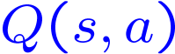
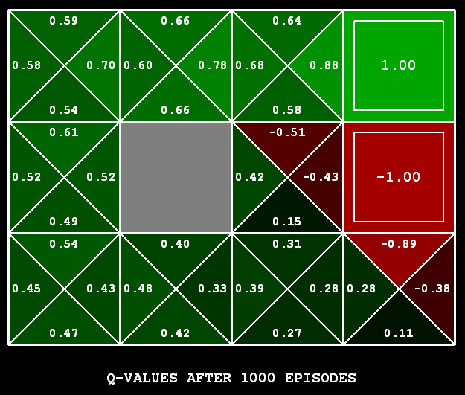
Q-Learning
Q-Learning: sample-based Q-value iteration
Learn Q(s,a) values as you go
Receive a sample (s,a,s’,r)
Consider your old estimate:
Consider your new sample estimate:
Incorporate the new estimate into a running average:
[Demo: Q-learning – gridworld (L10D2)]
[Demo: Q-learning – crawler (L10D3)]

Slide 47
Video of Demo Q-Learning -- Gridworld

Slide 48
Video of Demo Q-Learning -- Crawler

Slide 49

Q-Learning Properties
Amazing result: Q-learning converges to optimal policy -- even if you’re acting suboptimally!
This is called off-policy learning
Caveats:
You have to explore enough
You have to eventually make the learning rate
small enough
… but not decrease it too quickly
Basically, in the limit, it doesn’t matter how you select actions (!)

